Slide 1
19CSE312 -Distributed Systems
Lecture -1

Slide 2
Introduction
A distributed system is a computing environment in which various components are spread across multiple computers (or other computing devices) on a network. These devices split up the work, coordinating their efforts to complete the job more efficiently than if a single device had been responsible for the task
A distributed system is a collection of autonomous computing elements that appears to its users as a single coherent system.

Slide 3
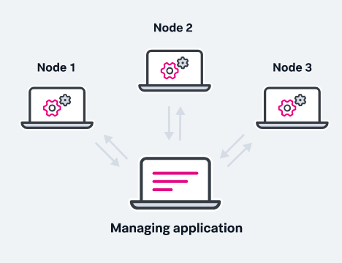
Elements
Autonomous computing elements, also referred to as nodes, be they hardware devices or software processes.
Single coherent system: users or applications perceive a single system=>
nodes need to collaborate.

Slide 4
key characteristics of a distributed system
Scalability: The ability to grow as the size of the workload increases is an essential feature of distributed systems, accomplished by adding additional processing units or nodes to the network as needed.
Concurrency: Distributed system components run simultaneously. They’re also characterized by the lack of a “global clock,” when tasks occur out of sequence and at different rates.
Availability/fault tolerance: If one node fails, the remaining nodes can continue to operate without disrupting the overall computation.
Transparency: An external programmer or end user sees a distributed system as a single computational unit rather than as its underlying parts, allowing users to interact with a single logical device rather than being concerned with the system’s architecture.

Slide 5
key characteristics of a distributed system
Heterogeneity: In most distributed systems, the nodes and components are often asynchronous, with different hardware, middleware, software and operating systems. This allows the distributed systems to be extended with the addition of new components.
Replication: Distributed systems enable shared information and messaging, ensuring consistency between redundant resources, such as software or hardware components, improving fault tolerance, reliability and accessibility.

Slide 6
Distributed tracing
Distributed tracing, sometimes called distributed request tracing, is a method for monitoring applications — typically those built on a micro-services architecture — which are commonly deployed on distributed systems.
Distributed tracing is essentially a form of distributed computing in that it’s commonly used to monitor the operations of applications running on distributed systems.
Tracing is used to follow the course of a transaction as it travels through an application.

Slide 7
Distributed tracing
Distributed tracing is necessary because of the considerable complexity of modern software architectures.
A distributed tracing system is designed to operate on a distributed services infrastructure, where it can track multiple applications and processes simultaneously across numerous concurrent nodes and computing environments.
Without distributed tracing, an application built on a micro-services architecture and running on a system as large and complex as a globally distributed system environment would be impossible to monitor effectively.

Slide 8
Benefits of distributed systems
Greater flexibility: It is easier to add computing power as the need for services grows. In most cases today, you can add servers to a distributed system on the fly.
Reliability: A well-designed distributed system can withstand failures in one or more of its nodes without severely impacting performance. In a monolithic system, the entire application goes down if the server goes down.
Enhanced speed: Heavy traffic can bog down single servers when traffic gets heavy, impacting performance for everyone. The scalability of distributed databases and other distributed systems makes them easier to maintain and also sustain high-performance levels.
Geo-distribution: Distributed content delivery is both intuitive for any internet user, and vital for global organizations.

Slide 9
Challenges of distributed systems
Increased opportunities for failure: The more systems added to a computing environment, the more opportunity there is for failure. If a system is not carefully designed and a single node crashes, the entire system can go down. While distributed systems are designed to be fault tolerant, that fault tolerance isn’t automatic or foolproof.
Synchronization process challenges: Distributed systems work without a global clock, requiring careful programming to ensure that processes are properly synchronized to avoid transmission delays that result in errors and data corruption. In a complex system — such as a multiplayer video game — synchronization can be challenging, especially on a public network that carries data traffic.
Imperfect scalability: Doubling the number of nodes in a distributed system doesn’t necessarily double performance. Architecting an effective distributed system that maximizes scalability is a complex undertaking that needs to take into account load balancing, bandwidth management and other issues.

Slide 10
Challenges of distributed systems
More complex security: Managing a large number of nodes in a heterogeneous or globally distributed environment creates numerous security challenges. A single weak link in a file system or larger distributed system network can expose the entire system to attack.
Increased complexity: Distributed systems are more complex to design, manage and understand than traditional computing environments.

Slide 11
Risks of distributed systems
Security: Distributed systems are as vulnerable to attack as any other system, but their distributed nature creates a much larger attack surface that exposes organizations to threats.
Risk of network failure: Distributed systems are beholden to public networks in order to transmit and receive data. If one segment of the internet becomes unavailable or overloaded, distributed system performance may decline.
Governance and control issues: Distributed systems lack the governability of monolithic, single-server-based systems, creating auditing and adherence issues around global privacy laws such as GDPR. Globally distributed environments can impose barriers to providing certain levels of assurance and impair visibility into where data resides.
Cost control: Unlike centralized systems, the scalability of distributed systems allows administrators to easily add additional capacity as needed, which can also increase costs. Pricing for cloud-based distributed computing systems are based on usage (such as the number of memory resources and CPU power consumed over time). If demand suddenly spikes, organizations can face a massive bill.

Slide 12
THANK YOU

